Slide 1
SPEED: A Stateless Protocol for Real-Time Communication in Sensor Networks
Tian He, John A Stankovic , Chenyang Lu, Tarek Abdelzaher
International Confernece on Distributed Computing Systems (ICDCS-23), Providence, RI, USA, pages 46-55, May 2003.
第二組 601430002黃霈哲 601430013黃煌彬

Slide 2
Outline
CH1: Introduction
CH2: SPEED
CH3: Evaluation
CH4: Multimodal Activity Based Localisation

Slide 3
CH1 Introduction
A real-time communication protocol for sensor networks, called SPEED.
Real-time constraints may exist
  Surveillance system
  Battlefield monitoring
  Earthquake response system
  Smart hospitals

Slide 4
CH1 Introduction
three types of communication patterns
  unicast
  area-multicast
  area-anycast
A protocol SPEED that supports soft real-time communication based on feedback control and stateless algorithms for large-scale sensor networks.

Slide 5
CH1 Introduction
evaluate SPEED via simulation using GloMoSim and compare it to five other ad hoc routing protocols: DSR, AODV, GF and two scaled down versions of SPEED.

Slide 6
CH2: SPEED

Slide 7
CH2 State of the Art
Location based routing algorithm
  Greedy Perimeter Stateless Routing (GPSR)
  Geographic distance routing (GEDIR)
  Location-Aided Routing (LAR)

Slide 8
CH2 State of the Art
Real-Time protocol
  Service Differentiation in Stateless Wireless Ad Hoc Networks (SWAN)
  Real-Time Communication Architecture for Large-Scale Wireless Sensor Networks (RAP)
  A Transmission Control Scheme for Media Access in Sensor Networks

Slide 9
CH2 State of the Art
Reactive routing algorithm
  Ad-hoc On Demand Distance Vector Routing (AODV)
  Dynamic Source Routing in Ad Hoc Wireless Networks (DSR)

Slide 10
CH2 Design Goals
Stateless Architecture
Soft Real-Time
Minimum MAC Layer Support
QoS Routing and Congestion Management
Traffic Load Balancing
Localized Behavior
Void Avoidance

Slide 11
CH2 SPEED Protocol
An API
A neighbor beacon exchange scheme
A delay estimation scheme
The Stateless Non-deterministic Geographic For-warding algorithm (SNGF)
A Neighborhood Feedback Loop (NFL)
Backpressure Rerouting
Last mile processing

Slide 12
CH2 SPEED Protocol

Slide 13
CH2 SPEED - API
AreaMulticastSend (position, radius, packet)
  It sends a copy of the packet to every node inside the specified area.
AreaAnyCastSend (position, radius, packet)
  This service sends a copy of the packet to at least one node inside the specified area.
UnicastSend (Global_ID, packet)
  The node identified by Global ID will receive the packet with a speed above a certain desired value.
SpeedReceive ( )

Slide 14
CH2 SPEED - Packet Format
PacketType: The type of communication: Area Multicast, AreaAnyCast or Unicast.
Global_ID: Only used in Unicast communication to identify a destination node.
Destination Area: Describes a three-dimensional space with a center point and radius in which the packets are destined.
TTL: Time To Live field is the hop limit used for last mile processing.
Payload.

Slide 15
CH2 SPEED - SNGF
The Neighbor Set of Node i: NSi is the set of nodes that are inside the radio range of node I .
The Forwarding Candidate Set of Node i: A set of nodes that belong to Nsi and are closer to the destination.

Slide 16
CH2 SPEED - SNGF

Slide 17
CH2 SPEED – SNGF_Rule
Packets are forwarded only to the nodes that belong to the FSi (Destination). If there is no node inside the FSi (Destination), packets are dropped and backpressure.
SPEED divides the neighbor nodes inside FSi (Destination)into two groups.
  Relay speeds > Ssetpoint
  Relay speeds < Ssetpoint (NFL)

Slide 18
CH2 SPEED – SNGF_Rule
The forwarding candidate is chosen from the first group, and the neighbor node with highest relay speed has a higher probability to be chosen as the forwarding Node.
If there are no nodes belonging to the first group, a relay ratio is calculated based on the Neighborhood Feedback Loop (NFL)

Slide 19
CH2 SPEED - NFL (MAC Layer Feedback)
API
UniCast
MultiCast
AnyCast
Last Mile Process
Backpressure
SNGF
NFL
Rerouting
Beacon
Neighbor
Delay
Exchange
Table
Estimation
MAC
Delay Estimation: Delay= Round Trip Time – Receiver Side Processing Time
Relay Ratio Control
On/Off Switch
Back-Pressure Rerouting

Slide 20
CH2 SPEED - Backpressure Rerouting based on MAC Layer Feedback & SNGF
ID
Delay
SPEED
9
0.5s
20
7
0.1s
110
7
11
10
0.4s
30
3
0.1s
115
Packet
Destination
Node 5's NT
5
Packet
9
2
Delay
3
10
Source
Boo

Slide 21
CH2 SPEED - Backpressure Rerouting based on MAC Layer Feedback & SNGF
ID Delay
5 0.1S
Packet (to 4)
7 0.4S
6
Node 6's NT
7
ID Delay
Beacon
Boo
5 0.5S
Delay
1
3
2 0.1S
4 0.1S
5
Node 3's NT
Packet 1
9
Packet 2
2
Packet 1
3
Packet 2
10
12
Packet 2
4
Packet 2
11
Packet 2

Slide 22
CH2 SPEED Last Mile Process
AreaMulticastSend(Center position, radius, deadline, packet)
AreaAnyCastSend(Center position, radius, deadline, packet)
UnicastSend(Global_ID,deadline,packet)
SpeedReceive()

Slide 23
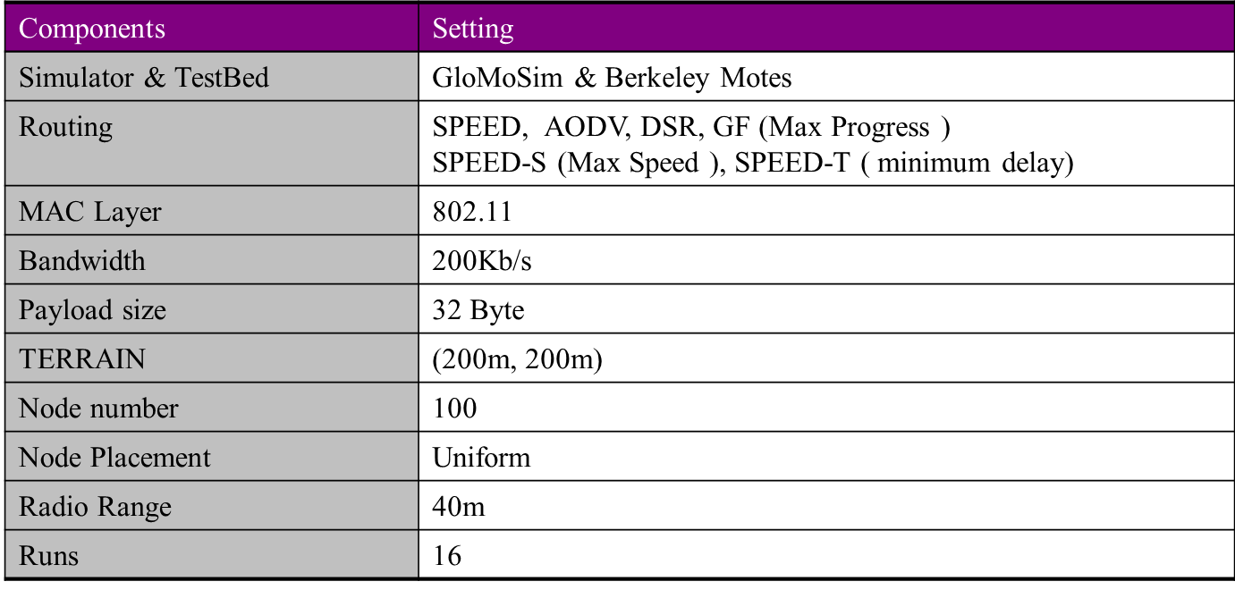
CH3 Evaluations

Slide 24
CH3 Evaluations - Congestion Avoidance

Slide 25
CH3 Evaluations - Control Overhead
Control Packets vs. Congestion-Level

Slide 26
CH3 Evaluations - Energy Consumption
40
Energy Consumption
35
30
25
20
15
AODV
DSR
10
SPEED
GF
5
SPEED-S
SPEED-T
Rate (P/S)
0
0
10
20
30
40
50
60
70
80
90
100
Energy Consumed vs. Congestion-Level

Slide 27
CH3 Evaluations - Void Avoidance
100%
95%
Delivery Rate
90%
DSR
SPEED
85%
GF
80%
SPEED-S
SPEED-T
75%
70%
15.5
13.9
12.6
11.4
10.4
9.5
8.7
8.0
Density (nodes per radio circle)

