Slide 1
A High-Throughput Path Metric for Multi-Hop Wireless Routing
Douglas S. J. De Couto Daniel Aguayo
John Bicket Robert Morris
M.I.T Computer Science and Artificial Intelligent Laboratory
MobiCom ’03, September 14-19, 2003, San Diego, California, USA.
Group 4
499415130 601415010 601441045
王維寬 林奕丞 鄭賜福

Slide 2
Outline
Introduction
Performance
EXT Metric Design
Implementation
Evaluation
Conclusions

Slide 3
Outline
Introduction
Performance
EXT Metric Design
Implementation
Evaluation
Conclusions

Slide 4
Introduction
Recent ad hoc routing protocols have focused on topologies and scalability.
Problems on the minimum hop-count protocol :
Link assumption is not correct to wireless case.
Minimizing the hop-count maximizes the distance.
Retransmission reduce path throughput.

Slide 5
The Solution - ETX
ETX means “expected transmission count metric”.
The primary goal :
Find path with high throughput.
ETX includes these considerations:
Link loss ratio.
Asymmetry.
Interference.

Slide 6
Following Topics
Section 2 :
Analysis of minimum hop-count.
Section 3 :
Design of ETX.
Section 4 :
Implementation of ETX.
Section 5 :
Evaluation on ETX
Section 6 :
Related works.
Section 7 :
Conclusion

Slide 7
Outline
Introduction
Performance
EXT Metric Design
Implementation
Evaluation
Conclusions

Slide 8
Section 2
Test-Bed
Path Throughput
Distribution of Path
Link Loss Ratio

Slide 9
Test-Bed
29 nodes consists of a Linux PC with 802.11b protocol.
Packet :
Total 193 bytes
Transmission time : 2218 ms
Preamble
Header
Data payload
Check
24 Bytes
31 Bytes
4 Bytes
134 Bytes

Slide 10
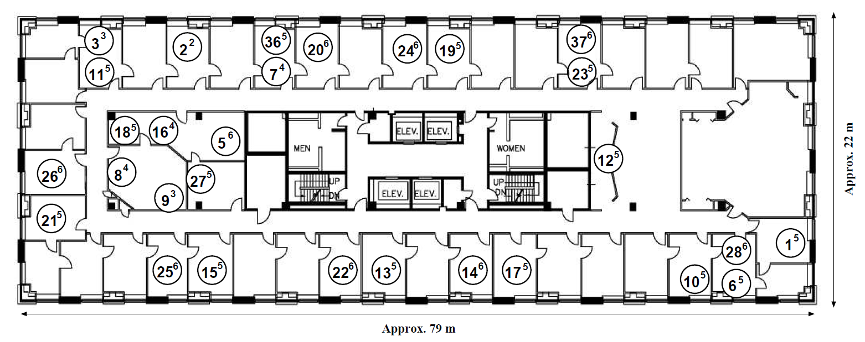
Test-Bed
Node positions :

Slide 11
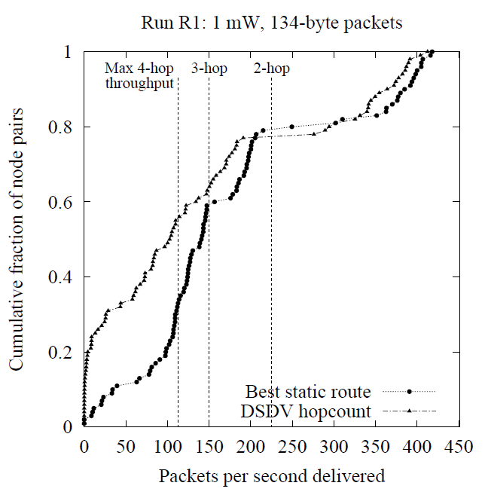
Path Throughputs

Slide 12
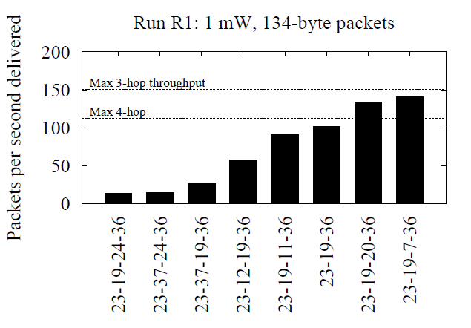
Distribution of Path
Route from node 23 to node 36.

Slide 13
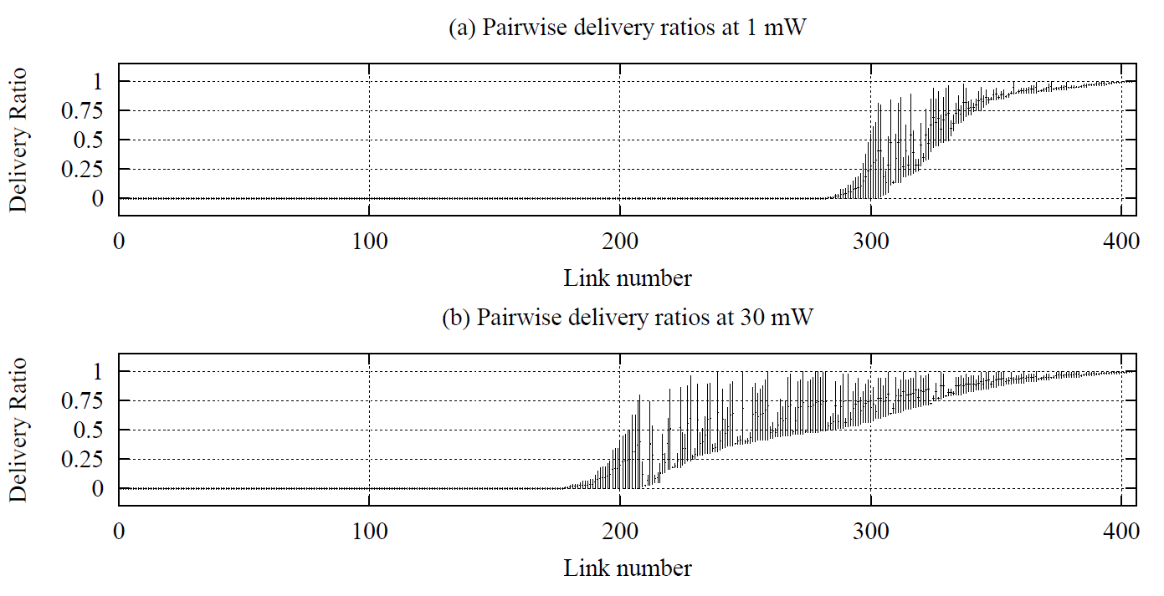
Link Loss Ratio

Slide 14
Outline
Introduction
Performance
EXT Metric Design
Implementation
Evaluation
Conclusions

Slide 15
Section 3
The Metric
ETX’s Characteristics
Delivery Ratio

Slide 16
The Metric
The ETX must account :
Link loss ratio
Asymmetric loss ratio
Interference
The metric formula :
d_{f} is the forward delivery ratio
d_{r} is the reverse delivery ratio

Slide 17
ETX’s Characteristics
ETX is based on delivery ratio.
ETX detects and handles asymmetry.
ETX use link loss ratio to make decision of route.
ETX penalize route with more hops.

Slide 18
Delivery Ratio
The delivery ratio formula :
τ is average period
w is the during seconds
t is any time
Count(t-w, t) is the number of probes

Slide 19
Outline
Introduction
Performance
EXT Metric Design
Implementation
Evaluation
Conclusions

Slide 20
Operation of DSDV
DSDV is a distance-vector protocol, which uses sequence numbers to ensure freshness, and a settling time mechanism to avoid unnecessarily propagating routes with inferior metrics.
Full dumps
2. Incremental
3. Bellman-Ford

Slide 21
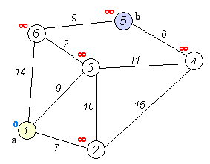
Bellman-Ford

Slide 22
Entry of DSDV
the destination’s identiﬁer (IP address),
the next hop on the route to that destination
the latest sequence number heard for that destination
the metric.
A node forwards packets to the next hop speciﬁed by the current contents of its routing table
Destination | Next Hop | Number of Hops | Sequence Number | Install Time
A | A | 0 | A 46 | 001000
B | B | 1 | B 36 | 001200
C | B | 2 | C 28 | 001500

Slide 23
Entry of DSDV
When a node receives another node’s route advertisement broadcast, it updates its own route entries as follows. Suppose node X
If n is newer than the sequence number in X’s current entry for the destination
if the sequence number is the same, but the metric is better than the current route’s.
If X has no route to the destination, it accepts the new route

Slide 24
WST
Each route entry has an associated weighted settling time (WST).
The settling time of a route entry with a given sequence number is the amount of time between when a route with the sequence number was ﬁrst received, and the time when the best route with the same sequence number was received.

Slide 25
Triggered update
Whenever a node replaces a route entry with a newly received entry, it propagates the new route to its neighbors by sending a triggered update which contains only the changed information.
In order to avoid an explosion of broadcasts. triggered updates are not sent until at least 2WST has passed since ﬁrst hearing the current sequence number

Slide 26
Change to DSCV
the waiting time before advertising a route should start when the ﬁrst route of each sequence number is heard.
does not use link level feedback (i.e. 802.11b transmission failures) to detect broken links and produce broken-route messages.
Triggered updates contain only the changed routes, and full dumps are only sent at the full dump period
The ﬁnal change (called delay-use) is that a route is not used until it is allowed to be advertised. That is, a new route is not used until 2WST has expired since its sequence number was ﬁrst heard.
The purpose of the last change is to prevent DSDV from using routes with bad metrics.

Slide 27
handle_route_ad(Packet p) {
foreach Route r in p do
handle_update(r)
}
handle_update(Route r) {
// curr[]: best route for current seq
// old[]: best route for previous seq
// add link-metric to r.metric
update_metric(r);
if (r.seq == curr[r.dest].seq && r.metric < curr[r.dest].metric) {
curr[r.dest] = r;
curr[r.dest].best_time = now;
schedule_triggered_update(r);
} else if (r.seq > curr[r.dest].seq) {
// save best route of last seq no
old[r.dest] = curr[r.dest];
curr[r.dest] = r;
curr[r.dest].first_time = now;
curr[r.dest].best_time = now;
// update settling time
old_wst = old[r.dest].wst;
best_t = old[r.dest].best_time;
first_t = old[r.dest].first_time;
curr[r.dest].wst = 0.88*old_wst +
0.12*(best_t - first_t);
schedule_triggered_update(r);
}
// ignore old seqnos and bad metrics
}
// returns next hop ip address for dst
lookup_route(IPAddress dst) {
// use old route if we haven’t yet
// advertised current route
if (curr[dst].first_time +
2*curr[dst].wst > now)
return old[dst].next_hop;
else
return curr[dst].next_hop;
}

Slide 28
DSR
DSR is a reactive routing protocol, in which a node issues a route request only when it has data to send. Route requests are ﬂooded through the network, each node appending its own address to each request it receives, and then re-broadcasting it. Each new request includes a unique ID, which forwarders use to ensure they only
The destination issues a route reply in response to every forwarded request it receives.

Slide 29
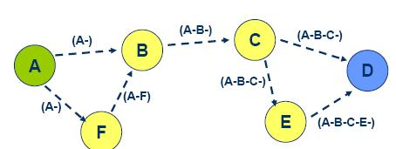
DSR
Route Discovery
Route Maintenance
No period broadcast
Dijkstra algorithm
Link cache

Slide 30
DSR
If a transmission failure occurs when forwarding a route reply, the neighbor to which the node was trying to forward the reply is added to the blacklist, with an entry of unidirectionality probable. From that point, the node will not forward route requests received over that link
If the asymmetry of the link is not positively determined for some time, its entry is downgraded to unidirectionality questionable. If a route request is received over such a link, the node delays forwarding it while it issues a direct, one-hop unicast route request back to the questionable neighbor. If a reply is received, the node forwards the original route request and removes the blacklist entry. Otherwise, the node drops the request.
Entries are removed from the blacklist when the link is determined to be bidirectional, e.g. by a successful unicast transmission

Slide 31
Outline
Introduction
Performance
EXT Metric Design
Implementation
Evaluation
Conclusions

Slide 32
Section 5
Metric Performance with DSDV
Metric Performance with DSR
Accuracy of Link Measurement

Slide 33
Section 5
Metric Performance with DSDV
Metric Performance with DSR
Accuracy of Link Measurement

Slide 34
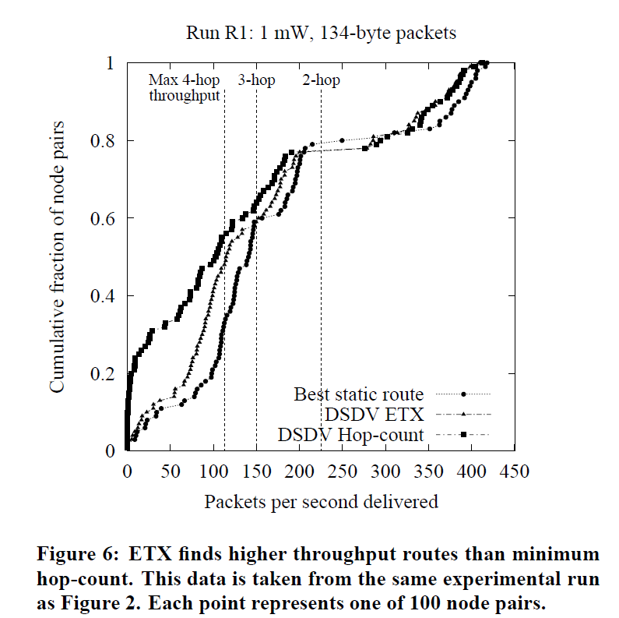
Metric Performance with DSDV

Slide 35
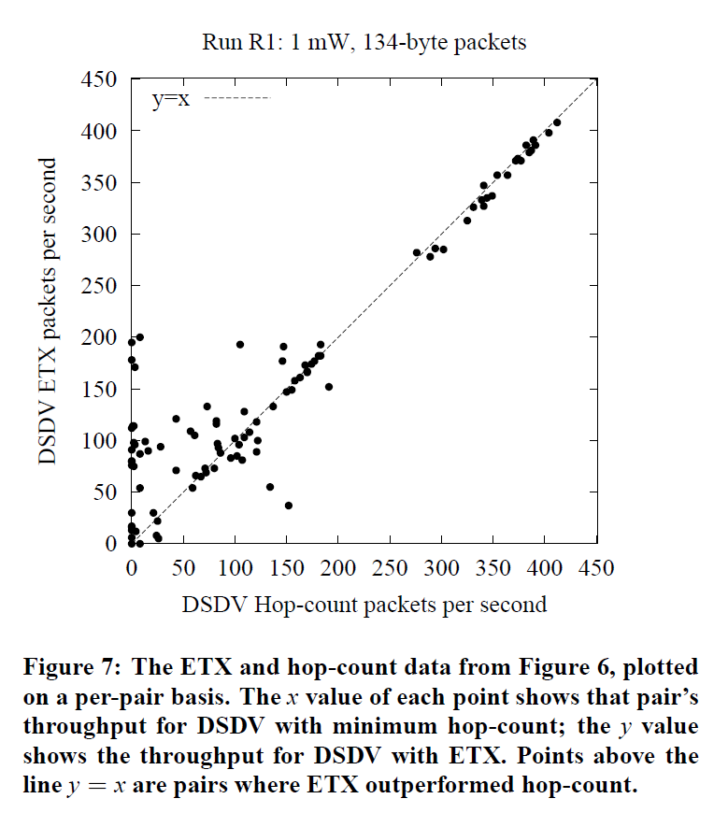
Metric Performance with DSDV

Slide 36
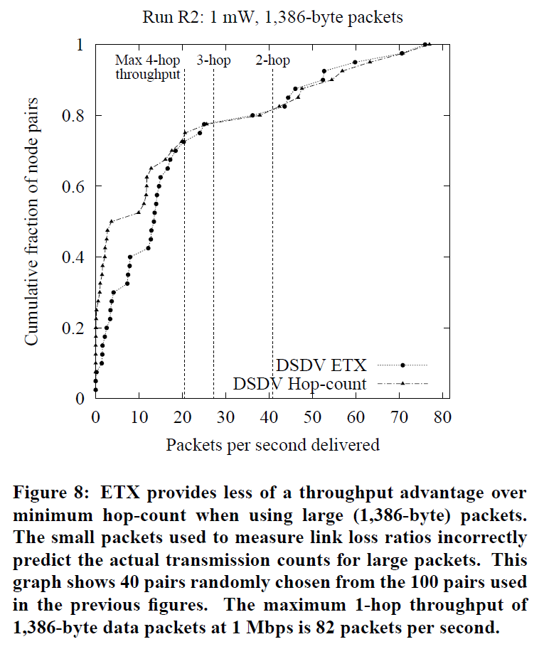
Metric Performance with DSDV

Slide 37
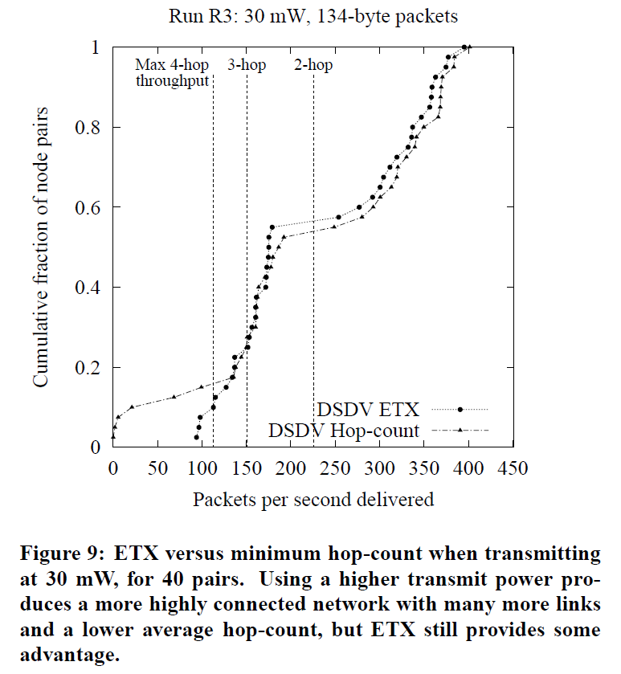
Metric Performance with DSDV

Slide 38
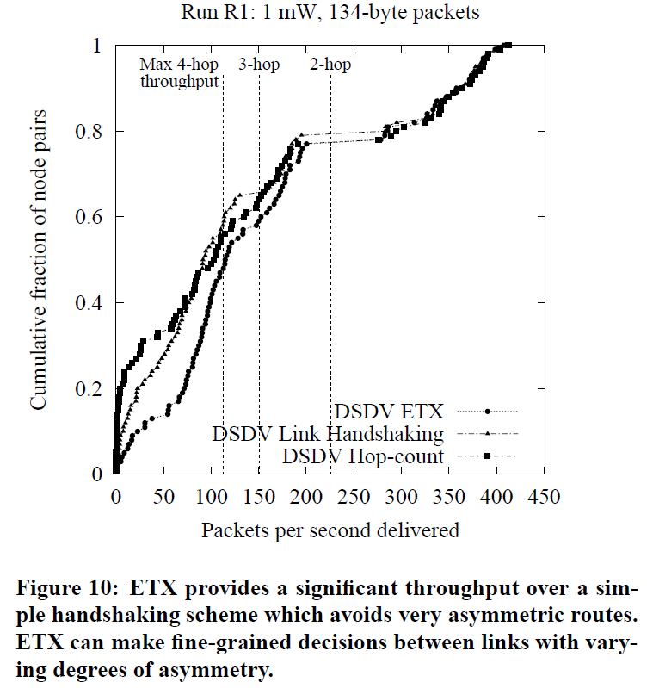
Metric Performance with DSDV

Slide 39
Section 5
Metric Performance with DSDV
Metric Performance with DSR
Accuracy of Link Measurement

Slide 40
Metric Performance with DSR
This section evaluates the performance of the DSR routing protocol with the ETX metric. DSR uses ink-layer transmission failure feedback to help it avoid bad routes. o isolate the effects of using ETX with DSR, we evaluated DSR performance both with and without link-layer feedback enabled.

Slide 41
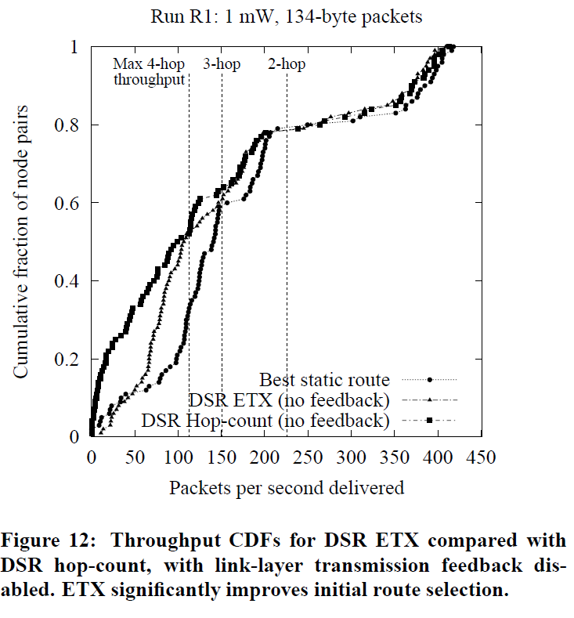
Metric Performance with DSR

Slide 42
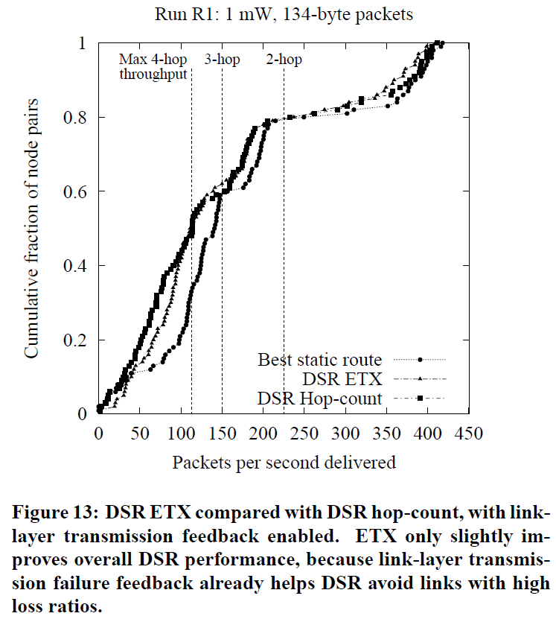
Metric Performance with DSR

Slide 43
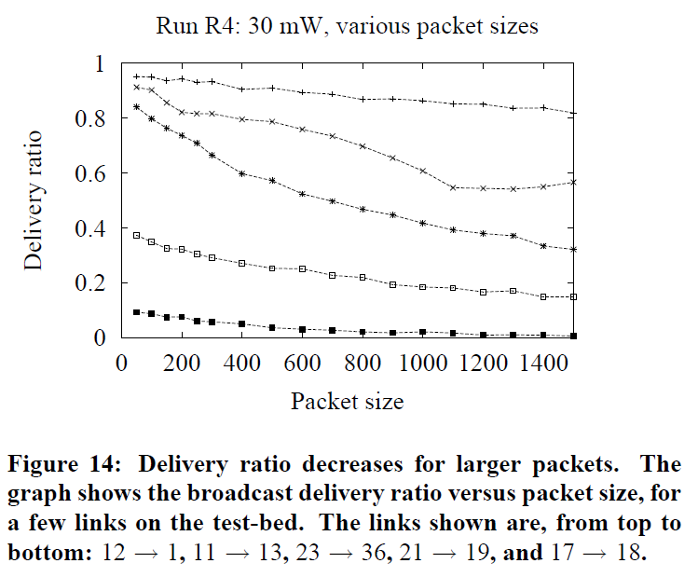
Accuracy of Link Measurement

Slide 44
Outline
Introduction
Performance
EXT Metric Design
Implementation
Evaluation
Conclusions

Slide 45
Conclusions
This paper introduces a new metric for multi-hop wireless networks , called ETX.
Measurements on a wireless test-bed show that ETX finds routes with significantly higher throughputs than a minimum hop-count metric, particularly for paths with two or more hops.
Several aspects of ETX could be improved in the future: its predictions of loss ratios for different packet sizes

Slide 46
End
Thanks for your attentions.

