Slide 1
Collection Tree Protocol
Gnawali, O., Fonseca, R., Jamieson, K., Moss, D., and Levis, P.
In SenSys '09.

Slide 2
Outline
Introdution
Motivation
Design Overview
Control Plane Design
Data Plane Design
Evaluation

Slide 3
Introdution
Two principle:
  datapath validation
  adaptive beaconing
Four goals
  Reliability
  Robustness
  Efficiency
  Hardware Independence
Why these two principle?
Be efficient→dynamism→
distance-vector→routing loop

Slide 4
datapath validation
  A node detects a possible routing loop when it receives a packet to forward from a node with a smaller or equal distance to the destination.
adaptive beaconing
  It extends the Trickle algorithm, originally designed for code updates.
  Adaptive beaconing can react in tens of milliseconds to topology changes, yet send a few control packets per hour when the topology is stable.

Slide 5
CTP
CTP Noe
  additional mechanisms and algorithms to improve performance, including re-transmit timers, a hybrid queue for forwarded and local packets, perclient queuing, and a duplicate suppression cache.
This paper evaluates CTP Noe on 12 different testbeds ranging in size from 20–310 nodes and comprising seven hardware platforms.

Slide 6
Motivation
robust, highly reliable, and efficient collection protocol
Collection protocol provides best-effort, unreliable, anycast packet delivery to sink in the network,but suffers from poor performance.
Why?
  link dynamics
  transient loops

Slide 7
Link dynamics
Protocols typically use periodic beacons to maintain topology and estimate link qualities.
Tradeoff: a faster beacon rate leads to a more agile network but higher cost, while a lower rate leads to a slower-to-adapt network and lower cost.
Protocols today settle for beacon rates on the order of tens of seconds, leading to typical rate mismatches of two to three orders of magnitude.
The beacon period would have to be in the order of few hundred milliseconds.(challenge)

Slide 8
Transient loops
In most variations of distributed distance vector algorithms, link topology changes may result in transient loops which causes packet drops.
The MultihopLQI protocol discards packets when it detects a loop until a new next hop is found.
In both cases, the problem is that topology repairs happen at the timescale of control plane maintenance, which operates at a time scale orders of magnitude longer than the data plane.

Slide 9
Design Overview
Collection is address-free
This paper assumes all data packets are simple unicast frames.
This section presents two mechanisms that enable a routing protocol to be robust to stale route information and agile to link dynamics while also having a low overhead when the topology is stable.
  Datapath Validation
  Adaptive Beaconing

Slide 10
Datapath Validation
Every node maintains an estimate of the cost of its route to a collection point.
assume expected transmissions(ETX) as the cost metric
Each data packet contains the transmitter’s local cost estimate.
When a node receives a packet to forward, it compares the transmitter’s cost to its own.
If cost not decreases , there may be a routing loop.

Slide 11
Adaptive Beaconing
Collection protocols typically broadcast control beacons at a fixed interval.
Adaptive beaconing achieves both fast recovery and low cost. It does so by extending the Trickle algorithm.
Trickle’s basic mechanism is transmitting the version number of a node’s code using a randomized timer.
2 mechanisms on top of this randomized transmission: suppression and adapting the timer interval.
  If a node hears another node advertise the same version number, it suppresses its own transmission.
  When a timer interval expires, Trickle doubles it, up to a maximum value (th).
  When Trickle hears a newer version number, it shrinks the timer interval to a small value (tl).
  If all nodes have the same version number, their timer intervals increase exponentially, up to th.

Slide 12
The routing layer resets the interval to tl on three events:
  It is asked to forward a data packet from a node whose ETX is not higher than its own.
  Its routing cost decreases significantly(ETX 1.5).
  It receives a packet with the P bit set.(new node)
Datapath validation and adaptive beaconing allow a routing layer to maintain an efficient yet agile topology, but are insufficient by themselves.

Slide 13
Control Plane Design(1/2)
Route Computation and Selection
  A CTP routing frame has two fields and two control bits. The two fields advertise the node’s current parent and routing cost. The two control bits are the pull bit (P) and the congested bit (C).
Control Traffic Timing
  When CTP Noe’s topology is stable, it relies on data packets to maintain, probe, and improve link estimates and routing state.
  Beacons form a critical part of routing topology maintenance.
  beacon interval varies between 64 ms and one hour

Slide 14
Control Plane Design(2/2)
Resetting the Beacon Interval
  3 events
  CTP Noe forwards data packets in a possible loop normally : it does not drop them.
  It introduces a slight pause in forwarding, the length of the minimum beacon interval.
  This ensures that it sends the resulting beacon before the data packet, such that the inconsistent node has a chance to resolve the problem.
  If the first beacon was lost, then the process will repeat.

Slide 15
Data Plane Design
the concerns are much more systems- and implementation-oriented.
four mechanisms achieve efficiency, robustness, and reliability:
  per-client queuing
  a hybrid send queue
  a transmit timer
  a packet summary cache
8 bytes header

Slide 16
Per-client Queuing
CTP Noe maintains two levels of queues. The top level is a set of one-deep client queues.
These client queues do not actually store packets; they are simple guards that keep track of whether a client has an outstanding packet.
When a client sends a packet, the client queue checks whether it is available. If so, the client queue marks itself busy and passes the packet down to the send queue.

Slide 17
Hybrid Send Queue
CTP Noe’s lower level queue contains both route through- and locally-generated traffic ,maintained by a FIFO policy.
When CTP Noe receives a packet to forward, it first checks if the packet is a duplicate.
Transmit Timer
A->B->C->D
waits in the range of (1:5p;2:5p), such that the average wait time is 2p but there is randomization to prevent edge conditions.

Slide 18
Transmit Cache
CTP Noe detects duplicates by examining three values: the origin address, the origin sequence number, and the THL.
When CTP Noe receives a packet to forward, it scans its send queue for duplicates. It also scans a transmit cache containing the 3-tuples of the N most recently forwarded packets.
a cache size of four slots is enough to suppress most (> 99%) duplicates

Slide 19
Evaluation
This paper evaluates their implementation of CTP Noe, using the 4-bit link estimator from , on 12 different testbeds, encompassing seven platforms, six link layers, multiple densities and frequencies.
The hope is that different testbed environments they examine sufficiently capture a reasonable degree of variation in hardware platforms, topology, and RF environment.

Slide 20
The min and max degree column are the in-degree of the nodes with the smallest and largest number of links.
link stability and quality
  PL, the average path length (hops a packet takes to the collection root)
  the average cost (transmissions/delivery)
  the node churn (parent change rate).
  cost/PL indicates how any transmissions CTP Noe makes on average per hop

Slide 21
Experimental Methodology
3 variables:
  the inter-packet interval (IPI) with which the application sends packets with CTP Noe
  the MAC layer used
  the node ID of the root node
pick roots that were in one corner of a testbed
6 different MAC layers
Evaluating efficiency is difficult;
compare CTP Noe with the TinyOS 2.1
implementation of MultihopLQI

Slide 22
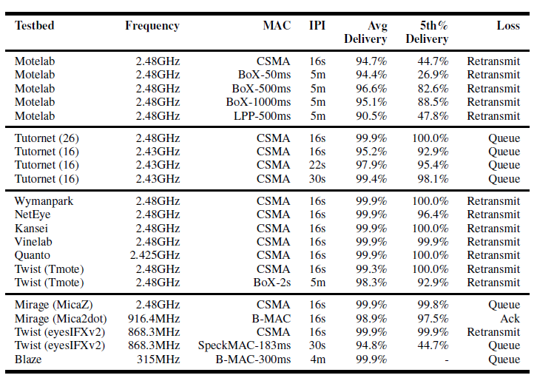

Slide 23
Reliable, Robust, Hardware-independent
chose IPI values well below saturation, such that available throughput does not limit the delivery ratio
Loss
  Retransmit : CTP Noe dropped a packet after 32 retransmissions
  Queue : it dropped a received packet due to a full forwarding queue
  Ack : it heard link layer acknowledgments for packets that did not arrive successfully

Slide 24
Reliability : average delivery ratio above 90%
Robustness and hardware independence :
  maintains its level of reliability across all configurations and settings, and requires configuration of a single constant, the expected packet transmission time, when used on different radio platforms.
Motelab:
  some Motelab nodes are only intermittently and sparsely connected(Table 1)

Slide 25
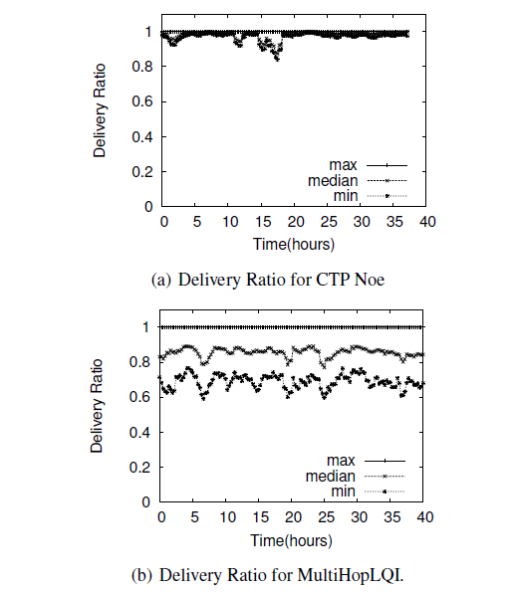
focus comparative evaluations on MultihopLQI
37 hours
L:0.58
A:0.85

Slide 26
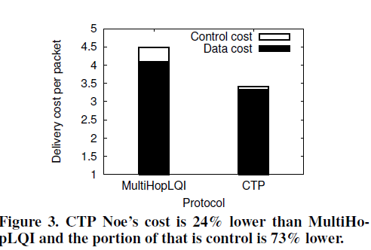
Efficiency
control packets:
2.2% vs. 8.4%
Data
  a result of good route selection and agile route repair
Control
  CTP Noe’s adaptive beaconing

Slide 27
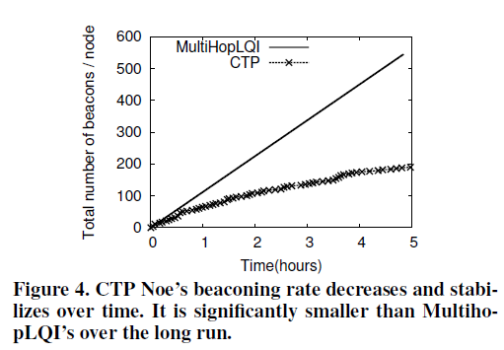
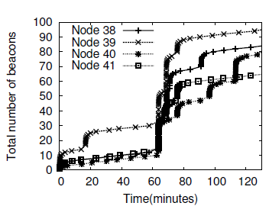
Adaptive Control Traffic
MultiHopLQI sends beacons at a fixed interval of 30 seconds.
CTP noe:64ms-1hr
4 nodes be added
Big jump

Slide 28
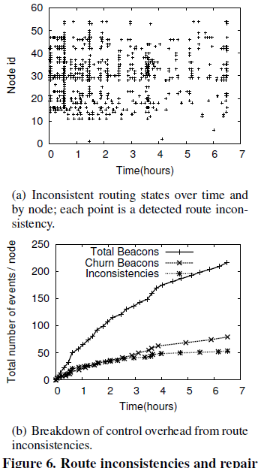
Topology Inconsistencies
(a) shows inconsistencies detected by each node in an experiment over a 6.5-hour period
In (b)
  Top curve: the total number of routing beacons sent.
  Middle curve: the subset of these beacons sent by the Trickle timer when a parent change resets the interval.
  Lowest curve : the cumulative count of route inconsistencies in the same experiment, and how the rate decreases over time
  The difference (T&M) provides an upper bound on the number of beacons sent due to inconsistencies.

Slide 29
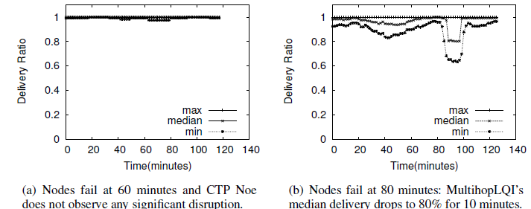
Robustness to Failure
To measure how effectively the routes can adapt to node failures, they ran CTP Noe for two hours with an IPI of 8s.

Slide 30
Agility
Ran CTP Noe on Tutornet with each node generating a data packet every eight seconds for six minutes, allowing it to settle on a good routing tree delivering 100% of the packets.
Stopped for 14 minutes.
At 20th minute , remove node 26, made node 53(child of 26) start sending
Packet failed as expected
After 12 packages(325ms),CTP noe switched node 40 as its new parent.

Slide 31
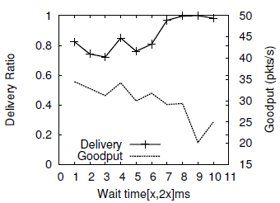
Transmit Timer
Figure 8 shows how the duration of a transmission wait timer affects a single node flow on channel 26 in the Tutornet testbed.
[8;16]ms:goodput drops significantly
CTP Noe uses 7–14ms (1.5–3 average packet times) as its wait timer

Slide 32
Transmit Cache
CTP Noe has an average cost of 3.18 packets/delivery.
Disabling the transmit cache increases this to 3.47 packets/delivery, a 9% increase.
The transmit cache improves CTP Noe’s efficiency by 9%.

Slide 33
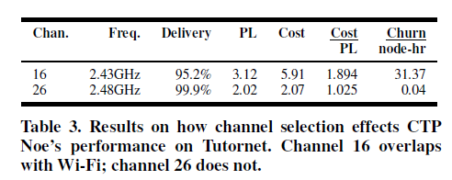
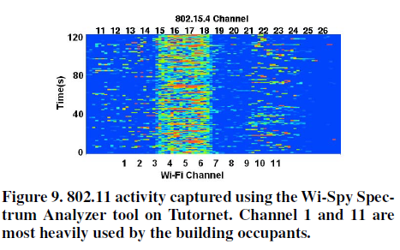
External Interference
Table 3 summarizes the differences between the ch16 and ch26.
Figure 9 shows Wi-Fi activity by Wi-Fi channel on the Tutornet testbed.
CTP Noe achieves high delivery even with high external interference

Slide 34
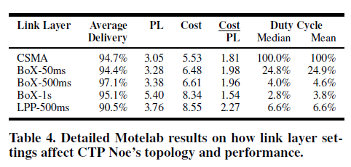
Link Layers
Low-power listening observes longer paths (higher average PL) and higher end-to-end costs, but the per-link cost(cost/PL) decreases.
Longer sleep intervals cause CTP Noeto choose longer routes of more reliable links.
Low-power probing generally under-performs lowpower listening.
For the same check interval, it has a lower delivery ratio and a higher duty cycle.

Slide 35
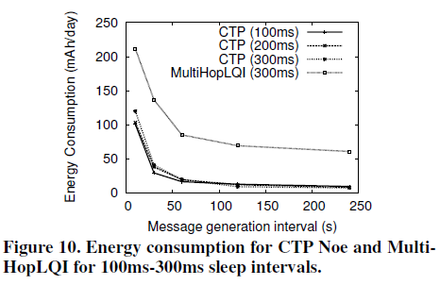
Energy Profile
They ran a total of 20 experiments for energy profiling, changing the MAC sleep interval and application data generation interval.
The result shows that CTP Noe with a properly-designed low power hardware platform can be used in long lasting deployments.(400days)
CTP Noe’s low energy profile is possible because it selects efficient paths, avoids unnecessary control traffic, and actively monitors the topology using the the data plane.

Slide 36
Testbed Observations
Churn
Motelab
  Very sparse and have only a few links with very low PRR
Tutornet
  sees bursty links due to bursts of 802.11 interference, causing nodes to change parents often
Kansei
  the high churn is due to the sheer degree of the network

Slide 37
RelatedWork
Hui at al.
This paper deeply evaluates CTP noe across a wide range of link layers, platforms, workloads, and environments, as well as examine the additional low-level systems issues that arise when incorporating them into a routing layer.

Slide 38
Experience
4 years
From a system implementation standpoint, the most important decision we made in CTP Noe’s design was including a detailed logging layer.
making protocols robust across environments is an open and critical research challenge

Slide 39
Conclusions
CTP Noe offers 90-99.9% packet delivery in highly dynamic environments while sending up to 73% fewer control packets than existing approaches.
Minimizing control traffic, combined with efficient route selection, allows CTP Noe to achieve duty cycles of < 3% while supporting aggregate loads of 25 packets/minute.
An open question worthy of future work is whether they are general to distance vector algorithms, and so may have broader applicability in ad-hoc networking.

