Slide 1
Simulation Tools for Wireless Sensor Networks
E. Egea-López, J. Vales-Alonso, A. S. Martínez-Sala,
P. Pavón-Marińo, J. García-Haro
Department of Information Technologies and Communications
Polytechnic University of Cartagena, Spain
Group 4
499415130 601415010 601441045
王維寬 林奕丞 鄭賜福

Slide 2
Outline
Introduction
A model for WSN simulation
Framework selection
WSN simulation software
Conclusions and open issues

Slide 3
Outline
Introduction
A model for WSN simulation
Framework selection
WSN simulation software
Conclusions and open issues

Slide 4
Introduction
Wireless Sensor Networks (WSN) can be considered a particular type of Mobile Ad-hoc network (MANETs),
WSNs and MANETs share similar technical
problems.
There are two specific factors in WSN: (a)network traffic
(b)energy
Deploying and operating a testbed

Slide 5
There are two key to obtain reliable conclusions
(a) The correctness of the model.
(b) the suitability of a particular tool to implement
the model.
the methodology and assumptions of simulations can lead to mistaken results.
─ Idealized hardware
─ protocols
─ non realistic radio model

Slide 6
Outline
Introduction
A model for WSN simulation
Framework selection
WSN simulation software
Conclusions and open issues

Slide 7
A MODEL FOR WSN SIMULATION
WSN simulation tools
(a) Network model
-node
-Environment
-Radio channel:
-Sink nodes
-Agents
(b) Node model
-Protocol tier
-physical-node tier
-media tier

Slide 8
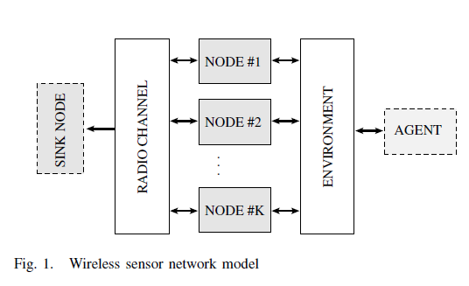

Slide 9
Network model
Node:
─ a physical device monitoring a set of physical
variables.
─ communicate via a common radio channel.
─ sensor modes is connected to environment.
─ WSN can contain from a few to several
thousands of nodes.

Slide 10
Environment:
─ environment component
(1)generation and propagation of events that
are sensed by the nodes
(2)trigger sensor actions
Radio channel:
─ Very detailed modelsuse a “terrain” component
Sink nodes:
─ receive data from the net
─ process data
Agents:
─ A generator of events of interest for the nodes.

Slide 11
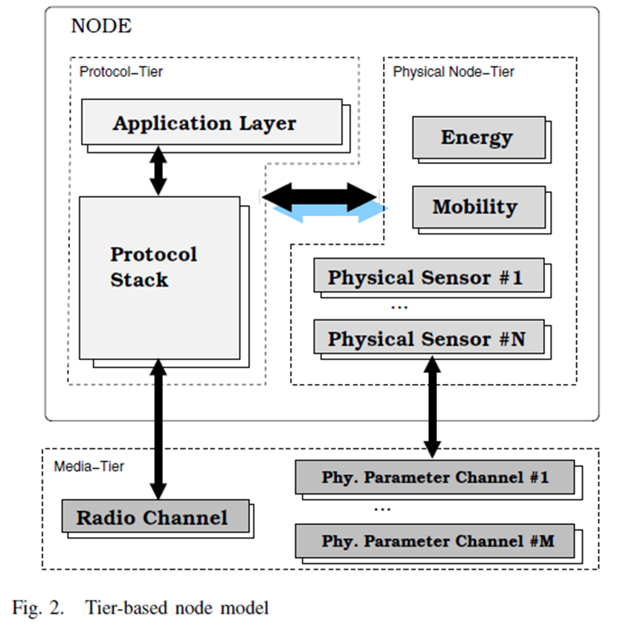
Node model

Slide 12
Protocol tier
(1) Comprises all the communication protocols.
(2) Three layers coexist at this tier:
─MAC layer
─ routing layer
─specific application layer.
(3) Depends on the state of the physical tier

Slide 13
Physical-node tier
(1)common elements
─ Set of physical sensors:
Describe the behavior of the monitoring
hardware
─ Energy module:
Simulates power consumption in the
component hardware
─ Mobility module:
Controls sensor position.

Slide 14
Media tier
(1) the link of the node with the “real world”
(2) connected with the environment through
─ radio channel
─ physical channel

Slide 15
Outline
Introduction
A model for WSN simulation
Framework selection
WSN simulation software
Conclusions and open issues

Slide 16
FRAMEWORK SELECTION
Existing WNS frameworks can be categorized In:
(1) Specific add-ons to general purpose
communication networks
(2) WSN frameworks built from scratch.
The long-way road to simulation
What may we expect from a good WSN simulator?

Slide 17
The long-way road to simulation
a simulation framework:
(a)smulation library
─ set of software libraries in a high level
programming language
(b)utility library
─graphical representation support
─statistical data gathering and analysis
(c)some scripting
─Tcl
─XML

Slide 18
What may we expect from a good WSN simulator?
─ Reusability and availability.
─ Performance and scalability.
─ Support for rich-semantics scripting languages
to define experiments and process results.
─ Graphical, debug and trace support.

Slide 19
Reusability and availability:
(1) implementation of common models
─ Early and widely adopted frameworks are
added to next releases.
(2) modify or integrate a new model with the
existing ones?
─ A careful structure with clean interfaces
and high modularity allows the user to easily
add or change functionality.

Slide 20
(3) typical requirements for WSN simulators:
─ Ad-hoc routing support plus wireless MAC
protocols
─ propagation and mobility models to synthesize
the physical node distribution
(4) All the specific frameworks are able to execute
native sensor code.

Slide 21
Performance and scalability:
(1) bounded to the programming language
effectiveness
(2) constrained to the memory, processor and
logs storage size requirements.
(3) type of simulation limit:
─ operate real time cannot be arbitrarily
long.

Slide 22
Support for rich-semantics scripting languages
to define experiments and process results.
(1) input scripting languages
─ high level semantics.
(2) output scripting language
─ obtain the results from the experiments
quickly

Slide 23
Graphical, debug and trace support.
(1) As a debugging aid
─ quickly detect a bad behavior is to “watch”
and follow the execution of a simulation.
(2) As a visual modeling and composition tool
─ facilitates and speeds the design of small
experiments
(3) as result plotters

Slide 24
Outline
Introduction
A model for WSN simulation
Framework selection
WSN simulation software
Conclusions and open issues

Slide 25
WSN simulation software
In this section, we focus on free, open-source, simulation tools.
Two kinds of simulation software :
General simulation packages
Specific WSN frameworks

Slide 26
General simulation packages
In this section, we focus on free, open-source, simulation tools.
Two kinds of simulation software :
General simulation packages
Specific WSN frameworks

Slide 27
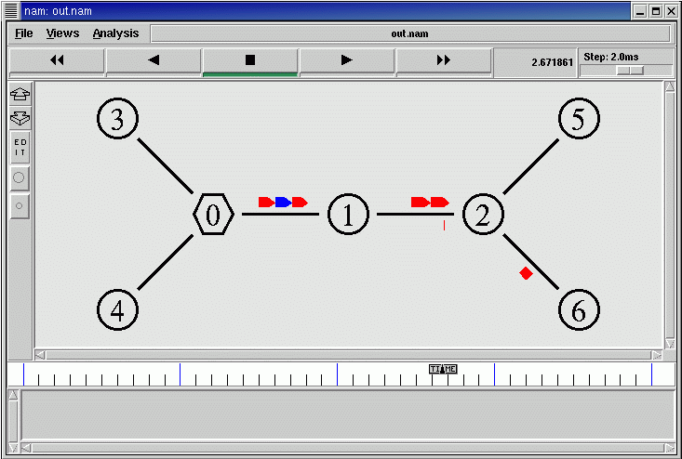
General simulation packages
NS-2
A discrete event simulator
Developed in C++
Advantages :
Most complete protocol models
Network up to 1000 nodes
Disadvantage :
Poor graphical support

Slide 28
General simulation packages
OMNET++
A discrete event simulator
Developed in C++
Advantages :
It’s simple due to its clean design
Powerful GUI library
Disadvantage :
Lack of available protocols

Slide 29
General simulation packages
J-Sim
Component-based simulator
Developed in Java
Advantages :
Considerable protocols
Reusable and interchangeable model
Provide GUI library
Disadvantage :
A 41 % worse execute time than NS-2

Slide 30
General simulation packages
NCTUns2.0
A discrete event simulator
Developed in Unix machine
Advantages :
Can be fed with real program data sources
High number of protocols
Worthy graphical edition capabilities
Disadvantage :
No specific designs for WSN
Hard to be available in Linux machine

Slide 31
General simulation packages
JiST / SWANS
A discrete event simulator
Developed in Java byte-code
Advantages :
Claim to scale to network of 10⁶ nodes
Better event throughput and memory consumption
Disadvantage :
Lack of enough protocol models
Only provide ad-hoc network

Slide 32
General simulation packages
GloMoSim
A simulation environment
Built with Parsec :
A language derived from C
Scale to 10,000 nodes
SSFNet
Set of Java network models
Built over the SSF
A specification of a common API for simulation
Simulation of very large scale networks

Slide 33
General simulation packages
Ptolemy II
A Java packages that support different models
Has simple and intuitive graphical composition

Slide 34
Specific WSN framework
TOSSIM
A discrete event simulator
Emulator of TinyOS with nesC code
Handle around a thousand of motes
Goal :
Study the behavior of TinyOS
Limitations :
Not capture energy consumption
Every node run the same code

Slide 35
Specific WSN framework
EmStar / EmSim / EmTOS
Platform : microservers
Ad-hoc systems with better hardware
EmTOS :
An extension of EmStar the enable nesC / TinyOS
Claim to handle over 500 nodes
ATEMU
An emulator of the AVR processor
Use in MICA platform
Advantages :
Capability of testing OS and application
Capability of simulating heterogeneous networks

Slide 36
Specific WSN framework
SENS
A discrete event simulator
Developed in C++
NesC can be used directly on it
Prowler / JProwler
A discrete event simulator on MATLAB
JProwler is the Java version
SNAP
An integrated hardware platform
2 way of usages :
The core of a deployed sensor
A part of an array of processors

Slide 37
Outline
Introduction
A model for WSN simulation
Framework selection
WSN simulation software
Conclusions and open issues

Slide 38
Conclusion and open issues
Simulation is essential due to :
Unfeasibility of analysis
Difficulties of setting up real experiments
The lack of protocols increase development time .
The parallel simulations perform better scale than sequential ones .
Bad graphical editors takes much time to create model.
All specific WSN framework is available of native code from actual devices.

Slide 39
End
Thanks for your attentions.

