Slide 1
Overview of Sensor Networks
499415130 王維寬
601415010 林奕丞
601441045 鄭賜福

Slide 2
Outline
Introduction
Sensor Network Applications
Embedded Network Technology
System Challenge
Self-organized Networks
Conserving Power And Bandwidth
Privacy
In This Issue

Slide 3
Outline
Introduction
Sensor Network Applications
Embedded Network Technology
System Challenge
Self-organized Networks
Conserving Power And Bandwidth
Privacy
In This Issue

Slide 4
Introduction
The science and technology are deeply intertwined.
The influence on the WSNs from technology :
Computing Capacity
Radios
Mechanical Structure

Slide 5
WSN’s constraints
Processing Speed
Storage Capacity
Communication Bandwidth

Slide 6
Energy Consideration:
Because of the long-periods operation and wireless, the energy resources limit overall operation.
The device’s components, including the radio, will likely be turn off most of the time.
Self-adjustment
Because manually configuring large networks of small
devices is impractical.

Slide 7
Outline
Introduction
Sensor Network Applications
Embedded Network Technology
System Challenge
Self-organized Networks
Conserving Power And Bandwidth
Privacy
In This Issue

Slide 8
Sensor network applications
Monitoring space
Monitoring things
Monitoring the interactions of things with each other and the encompassing space

Slide 9
Environmental monitoring
Nesting seabird habitats
Microclimate chaparral transects
Conducting analogous studies of contaminant propagation
Building comfort
Intrusion detection

Slide 10
Environmental monitoring
Monitoring the microclimate throughout the volume of redwood trees
Climatic factor :
Photosynthesis
Water and nutrient transport
Growth patterns

Slide 11
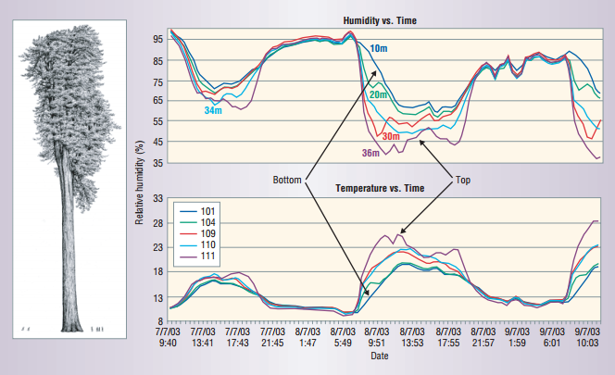
Environmental monitoring
WSN climate data. The WSN samples climate data every ﬁve minutes and computes an average temperature at each elevation.

Slide 12
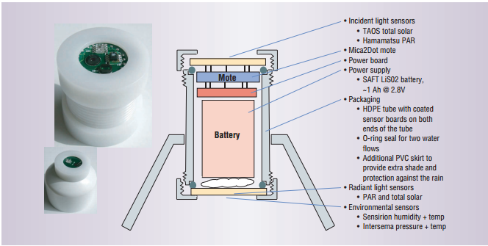
Environmental monitoring
Wireless sensor node for environmental monitoring. An entire wireless weather station ﬁts in a tube about the size of a ﬁlm canister.

Slide 13
Motion monitoring
Physical structure:
Vibration
Acoustic emissions
Response to stimuli
WSN can performing local process at each device and transporting the data continuously to operations staff

Slide 14
Outline
Introduction
Sensor Network Applications
Embedded Network Technology
System Challenge
Self-organized Networks
Conserving Power And Bandwidth
Privacy
In This Issue

Slide 15
Embedded Network Technology
WSNs merge a wide range of information technology that spans hardware, systems software, networking, and programming methodologies.

Slide 16
WSN hardware
Data storage
Sensors
ADC
Data transceiver
Controller
Energy source (Ex :solar cells, vibration of windows, air condition ducts)

Slide 17
WSN hardware
Low-power microcontroller have limited storage, typically less than 10K bytes of RAM .

Slide 18
Microsensors
Physical phenomena Voltage (change resistance)
Binary number
Microelectromechanical systems(MEMS)
High-precision piezoelectric accelerometers(expensive)
Sufficient-precision MEMS(cheap)

Slide 19
Microradios
Consumption
Wireless LANs and cell phones : hundreds of milliwatts
WSN radios : 20 milliwatts(range : tens of meters)
Communication remains one of the most energy-consuming operations.
→ 1 bit costs as much as 1000 instructions.

Slide 20
Outline
Introduction
Sensor Network Applications
Embedded Network Technology
System Challenge
Self-organized Networks
Conserving Power And Bandwidth
Privacy
In This Issue

Slide 21
System Challenge
The network must allocate limited hardware to multiple concurrent activities(sampling sensors, processing and streaming data)

Slide 22
Tiny OS
Focusing on structured interaction with the physical world, rather than on complex human interactivity.
Each component handles certain events and signals actions in other components, but they never consume processor cycles while waiting for future events.

Slide 23
Lower level of network
Acquiring the radio channel
Framing data stream into packet
Error coding
Channel scheduling
Detecting and process the incoming packets

Slide 24
Higher level of network
Buffer management
Authentication
Multiplexing the network
Receiving and processing a stream
Delivering important notification

Slide 25
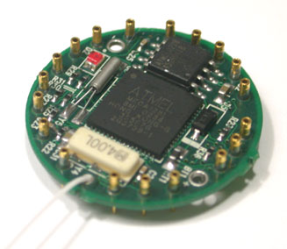
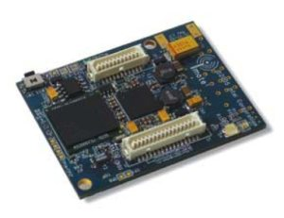
Network sensor platforms
Berkeley Motes :
Sensing capacities
Communication radio
Computation unit
Power source
Intel iMote
ARM processor
Storage
Radio : The Bluetooth standard

Slide 26
Outline
Introduction
Sensor Network Applications
Embedded Network Technology
System Challenge
Self-organized Networks
Conserving Power And Bandwidth
Privacy
In This Issue

Slide 27
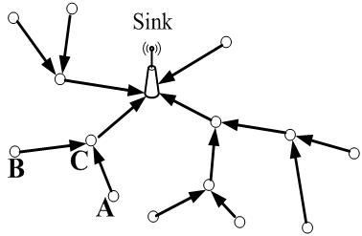
Self-organized Networks
A network consists of many nodes, each with multiple links connecting to other nodes. Information moves hop by hop along a route from the point of production to the point of use.

Slide 28
Connectivity
When one node transmits
the link layer listens on the channel and transmits only
when the channel is clear.
When not transmitting
nodes sample the channel and scan for a special symbol
at the start of a packet that also lets the receiver align
itself with the sender’s time.

Slide 29
Dissemination and data collection
the network uses the identifying information to detect and suppress duplicates.
The flooding protocols use various techniques to avoid contention and minimize redundant transmissions
The root can be a gateway to a more powerful network or an aggregation point within the sensor network, as determined by some higher-level task.

Slide 30
Usage of dissemination
Issuing commands
Convey alarms
Configuring and tasking the network
Establishing routes

Slide 31
Reliability
Increasingly, sensor networks will deploy disruption tolerant networking(DTN) approaches in which they transfer bundles of data reliably, hop by hop.

Slide 32
Outline
Introduction
Sensor Network Applications
Embedded Network Technology
System Challenge
Self-organized Networks
Conserving Power And Bandwidth
Privacy
In This Issue

Slide 33
Conserving Power And Bandwidth
Communication, usually the most energy-intensive operation a node performs, must contend for a share of limited bandwidth.
Performing aggregation within the network can reduce communication.
Compression and scheduling also can conserve energy at lower layers.

Slide 34
Outline
Introduction
Sensor Network Applications
Embedded Network Technology
System Challenge
Self-organized Networks
Conserving Power And Bandwidth
Privacy
In This Issue

Slide 35
Privacy
Fortunately, this area has become an active focus of research while the technology is still in its early stages

Slide 36
Outline
Introduction
Sensor Network Applications
Embedded Network Technology
System Challenge
Self-organized Networks
Conserving Power And Bandwidth
Privacy
In This Issue

Slide 37
In This Issue
The articles in this special issue span novel sensor network applications, embedded network technology, and systems design challenges.
Articles:
Date gather
Traffic
Detect sniper
Low power
Curriculum

Slide 38
Conclusion
WSNs appear to represent a new class. They follow the trends of size, number, and cost, but have a markedly different function. Rather than being devoted to personal productivity tasks, WSNs make it possible to perceive what takes place in the physical world in ways not previously possible.

Slide 39
END
Thanks for your attention!!

